Slide 1
Transactions
— Chapter 17
2021年12月
叶文
yewen@bupt.edu.cn
School of Computer Science (National Pilot Software Engineering School)

Slide 2
C, C++, Java programs
query
程 序 编 译 / 编译器
词法/语法/语义分析
Query processing / DBMS
扫描和语法/语义分析
中间代码生成
关系代数表达式&查询树
Chapter15, 16
(中间)代码优化
查询优化
(§16)
(优化后)查询执行计划
目标代码生成
查询代码生成
(§15)
目标程序代码
查询计划执行的代码
process / thread
事务处理 / DBMS
transaction
程序执行 /
进程管理
&进程调度
并发控制
死锁处理
事务管理
&事务调度
并发控制
恢复技术
Chapter 17, 18, 19
死锁处理
OS
(§19)
(§17)
(§18)
Fig. 17.0.1

Slide 3
Part 5 TRANSACTION MANAGEMENT
Part 5
Chapter 17 Transactions
Chapter 18 Concurrent Control
Chapter 19 Recovery System
DBS中，从DBMS的角度，用户对DB的访问体现为DBS中1个或多个数据库事务(transaction)的执行
select, insert, delete, update
transaction类似于process, thread
事务是DBS中应用程序/数据库应用系统的基本逻辑单位，也是DBMS管理DBS运行的基本单位, §17.1/17.2
多用户DBS中，多个用户对DB的并发访问体现为DBS中多个数据库事务的并发执行
事务是动态的，具有一定生命周期
事务具有多种状态，事务的执行体现为各状态间的转换过程, §17.4, Fig.17.1

Slide 4
TRANSACTION MANAGEMENT
在DBS中，事务执行时，特别是当多个事务对共享数据进行并发访问时，为维护DBS系统中数据的正确性(一致性integrities)，事务必须满足一定的约束条件，表现为事务的4个基本特征(ACID) ,§17.1/17.2/17.4/17/5
原子性(atomicity)，一致性(consistency)，独立性/隔离性(isolation)，永久性/ 持续性/操作结果永久保持性 (durability)
DBMS中的recovery-management component负责保障事务的原子性(§19)
事务设计者/DBS应用程序编程者负责保障事务的一致性
DBMS中的concurrency-control component负责保障事务的独立性(§18)
isolation level
locking, timestamp, multiple-granularity, multiple-version
DBMS中的recovery-management component负责保障事务的永久性(§19)

Slide 5
TRANSACTION MANAGEMENT
当DBS中存在多个并发事务时，DBMS通过事务调度对各事务进行并发控制 (§18.4)，以保证并发事务的运行结果正确性
DBMS中的concurrency-control component依据事务调度可串行性(Serializability)的基本原理，对事务进行并发控制和调度,§18.6
具体实现技术
1. 基于锁的并发控制技术(§18.1) —— Reader/Writer Model
2. 多粒度控制技术(§18.3)，多版本控制(§18.6)
3. 隔离级别——tradeoff between 一致性/正确性与访问效率
4. 基于时间戳的并发控制技术(§18.4)
5. 基于验证的并发控制技术(§18.5)
此外， DBMS的concurrency-control component还需要对多个并发执行的事务进行死锁处理(§18.2)

Slide 6
Chapter 17 Transactions: Outline
Transaction Concept
ACID
Transaction State
Concurrent Executions
Serializability
Recoverability
Implementation of Isolation
Testing for Serializability
Transaction Definition in SQL
database access by transactions
transaction properties

Slide 7
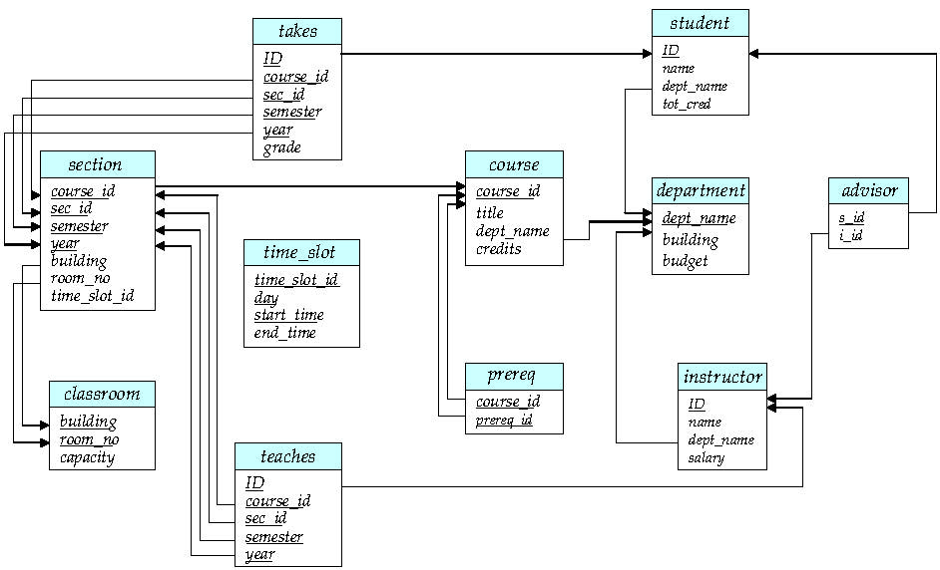
return

Slide 8
17.1 Transaction Concept
The transaction is
a unit of DBS application program executing that accesses and possibly updates various data items in DB
A transaction is initiated by a user application program written in
data manipulating language such as SQL, for example select-from-where, or
programming languages, e.g. C++ or Java, with embedded DB accesses in JDBC or ODBC
A transaction consists of
a collection of operations that form a single logic unit of application works, delimited by the statements of the form begin transaction and end transaction
operations: read or write on DB, or other operations
begin-transaction
op₁;
op₂;
.
op_{n};
end-transaction (e.g. commit or abort/rollback)

Slide 9
Transaction Concept
Conceptually, a transaction can be defined by read and write meta operations【逻辑读、逻辑写】, which are independent of DBS query languages (e.g. SQL) and DBMS (e.g. SQL Server)
E.g.1. Account-transfer T1 : transfer $50 from account A to account B
T1 : begin-transaction
read (A );
A := A -50;
write (A );
read (B );
B := B + 50;
write (B );
end-transaction
Two main issues to deal with
failures of various kinds, such as hardware failures and system crashes
concurrent execution of multiple transaction

Slide 10
Transaction with roll back
begin-transaction
read (A );
A:= A -50;
if A < 0 then
then begin
print(‘insufficient funds’)
rollback T2
end
else begin
write (A);
read (B);
B := B + 50;
write (B);
commit T2
end
abort/rollback T2: 撤销之前对loan_A 的修改, 即恢复loan_A 的原值，并立即结束T2，不再执行其后的各操作

Slide 11
SC(s#, c#, grade)
insert into MaxGrade(c#, maxG)
select c#, max(grade)
from SC
group by c#
update SC
set grade=grade +5
where c#=301141
read(SC(s#, c#, grade))
write(MaxGrade(c#, maxG))
read(SC.c#)
read(SC.grade)
write(grade)

Slide 12
DECLARE @transfer_name varchar(10) /*事务变量定义*/
SET @transfer_name = ‘I-transfer-from-A-to-B’ /*事务命名*/
BEGIN TRANSACTION @transfer_name /*事务开始*/
USE ACCOUNT /*打开数据库ACCOUNT*/
GO /*将上述批SQL语句提交SQL Server*/
UPDATE A /* 修改A帐户*/
SET balance = balance – 50
WHERE branch_name= ‘Brooklyn’
UPDATE B /* 修改B帐户*/
SET balance = balance + 50
WHERE branch_name= ‘Brooklyn’
GO
COMMIT TRANSACTION @transfer_name /*事务提交*/
GO
Fig.17.0.2 transfer T₃ in T-SQL programs

Slide 13
17.2 A Simple Transaction Model
Each data access in transactions, such as select, Update in SQL, or API in ODBC, is translated/decomposed by DBMS into one or more read and write operations
Refer to Fig. 17.0.3
DBMS executes these read and write operations to fulfill data access in transactions
For each transaction, DBMS allocates a local buffer in main memory as the working area for this transaction
The database permanently resides on disk, but some portion of it is temporarily residing in the disk buffer in main memory

Slide 14
A Simple Transaction Model
read(X)
transfer the data item X from DB files on disk or the disk/system buffer to a variable, also called X, in the local buffer belonging to the transaction that executes the read operation
write(X)
conceptually, transfer the value in the variable X in the the local buffer of the transaction that execute the write operation back to the data item X in the DB files on disk
In real DBS, the write operation issued by transactions does not necessarily result in the immediate update of the data on the disks, this operation may be temporarily stored in the system buffers and executed on the disk later
refer to Fig. 17.0.3

Slide 15
Transaction
e.g. name
salary in Instructor
data accesses on data item x and y issued by T_{i},
e.g. select, insert, delete, update, …
DBMS
x_{i}, y_{i}
local buffer for transaction T_{i}
逻辑读写
read(x)
write(y)
B_{X}
B_{Y}
…
B_{Z}
disk buffer
物理读写
input(X)
output(Y) / reflect / 持久化 when checkpoint or commit
B_{X}
B_{Y}
…
B_{Z}
B_{W}
DB file on disk
Fig.17.0.3 read and write operations
B_{U}
B_{V}
…
B_{Q}
B_{R}

Slide 16
Example of Fund Transfer
Transaction to transfer $50 from account A to account B:
A=1000 B=2000 A + B = 3000
1. read(A)
2. A := A – 50
3. write(A) A=950 B=2000 A+B=2950
4. read(B)
5. B := B + 50
6. write(B) A=950 B=2050 A+B=3000

Slide 17
Consistency in Example
Execution of a transaction in isolation (that is, with no other transaction executing concurrently) preserves the consistency of the DB, i.e. before and after the transaction execution, DB is in a correct DB state
1个事务的正确执行使得DB从一个正确状态转移到另一个正确状态
DB state: contents of tables in DB, or DB instance
Consistency requirement in above example:
The sum of A and B is unchanged by the execution of the transaction
i.e. A + B = 3000
A=1000,B=2000
A+B=3000
Consistency/correctness
integrity constraints, specified by the application logic, are not violated, e.g. age>0, A+B=3000
1. read (A);
2. A := A -50;
3. write (aA );
4. read (B )
5. B := 50;
6. write (accB );
A=950, B=2050
A+B=3000

Slide 18
Consistency in Example (Cont.)
In general, consistency requirements include
Explicitly specified integrity constraints such as primary keys and foreign keys
Implicit integrity constraints
e.g., sum of balances of all accounts, minus sum of loan amounts must equal value of cash-in-hand
A transaction must see a consistent database
During transaction execution the database may be temporarily inconsistent
//事务执行过程中，有可能处于不一致状态
e.g. A+B=2950 after step 3 and before step 6
When the transaction completes successfully the database must be consistent
Erroneous transaction logic can lead to inconsistency, e.g. A=A-50, B=B+40
Ensuring consistency of an individual transaction is the responsibility of the application programmers who codes the transaction

Slide 19
 | attribute-level | tuple-level | relation-level
static | data type data format, e.g. YY.MM.DD domain constraints, e.g.1 null value, e.g. not null | constraints among attributes values e.g.2 mapping cardinality constraints | entity integrity e.g.3 referential integrity functional dependency (§8) statistical constraints e.g.6
dynamic | constraints on updating of attribute values or attribute definition e.g.4 | constraints among attributes values e.g.5 | transaction constraint: atomy, consistency, isolation, durability (§ 17, 18, 19)
return

Slide 20
Examples of Integrity Constraints
E.g.1 the salary of manager should not be lower than $1000 in Employee
E.g.2 table T (x, y, z ), z =x+y, z is a derived attributes from x and y.
E.g.3 the student# for table student should not be null
E.g.4 the age of students should only be added
E.g.5 when employee tuples is modified, new.sal > old.sal + 0.5*age
E.g.6 statistical constraints
in table employee , “the salary of manager should be four times more than that of workers”

Slide 21
Atomicity
Either all operations of the transaction are reflected/持久化 ( ) properly in the database, or none are
/*事务中所有操作或者全部成功完成，并且这些操作结果 被写入到DB；或者事务中的所有操作一个都不作, 该事务对数据库和其他事务没有任何影响
/*将事务所有操作作为1个不可分割的整体
The system should ensure that updates of a partially executed transaction are not reflected in the database
The log-based recovery component in DBMS is responsible for ensuring atomicity
A=1000, B=2000
E.g. If the transaction fails after step 3 and before step 6, money will be “lost” leading to an inconsistent database state
failure could be due to software or hardware
1. read (A);
2. A := A -50;
3. write (aA );
4. read (B )
5. B := 50;
6. write (B );
A=950, B=2000

Slide 22
Isolation
Even though multiple transactions may execute concurrently, the system guarantee that all transactions seem to execute serially, so the consistent states of DB can be preserve
each transaction is unaware of other transactions executing concurrently in the system
/*对多个并发执行的事务，1个事务的执行不能被其他事务干扰，即1个事物的内部操作和数据对其它事务是隔离的，并发执行的事务间不能相互干扰，从执行结果来看，相当于事务串行执行
Isolation guarantees the correctness of concurrent execution of more than one transactions
The concurrency control component in DBMS ensures the isolation properties

Slide 23
E.g. if between steps 3 and 6 (of the fund transfer transaction) , another transaction T2 is allowed to access the partially updated database, it will see an inconsistent database (the sum A + B will be less than it should be)
T1 T2
1. read(A)
2. A := A – 50
3. write(A)
read(A), read(B), print(A+B)
4. read(B)
5. B := B + 50
6. write(B)
Isolation can be ensured trivially by running transactions serially, that is, one after the other; however, executing multiple transactions concurrently has significant benefits, as we will see later
A=1000, B=2000
The Reader-Writer problem
A=950, B=2000

Slide 24
Durability in Example
Once the user has been notified that the transaction has completed, the updates to the database by the transaction must persist even if there are software or hardware failures
the modified values of A and B in DB buffer should be reflected/write to database file on disk
/*事务一旦提交（成功完成），它对数据库中数据的改变就应该是永久性的——持久化，这些改变不随其后的数据库系统错误而丢失
Durability is ensured by log-based recovery management component
E.g.1 the transfer of the $50 has taken place, the updates to the database by the transaction must persist even if there are software or hardware failures
E.g.2 the modifications on Y in Fig.15.0.3
the modified results in local buffer/disk buffer should be reflected/持久化 to the DB file on disk

Slide 25
e.g.2. for T₃ in Fig.17.0.2
begin-trans.; update(A) ; update(B) ; commit
local buffer
for T₃
a=950
a=1000
a=950
b=2050
disk buffer
a=1000
a=950
a=950
b=2050
a=950
b=2050
A=1000
B=2000
A=1000
B=2000
A=1000
B=2000
A=950
B=2050

Slide 26
ACID Properties
To preserve the integrity of data the database system must ensure:
Atomicity. Either all operations of the transaction are properly reflected in the database or none are.
Consistency. Execution of a transaction in isolation preserves the consistency of the database
Isolation. Although multiple transactions may execute concurrently, each transaction must be unaware of other concurrently executing transactions. Intermediate transaction results must be hidden from other concurrently executed transactions.
That is, for every pair of transactions T_{i} and T_{j}, it appears to T_{i} that either T_{j}, finished execution before T_{i} started, or T_{j} started execution after T_{i} finished——好像两者串行执行
Durability. After a transaction completes successfully, the changes it has made to the database persist, even if there are system failures

Slide 27
ACID Properties
ACID mechanisms in DBS
A : transaction management / recovery management component
C: programmer/transaction designer, integrity constraints testing mechanism in DBMS
I: concurrency control component
D: recovery management component

Slide 28
17.4 Transaction Atomicity and Durability/States
A transaction is termed aborted(夭折), if it may not complete its execution successfully
A transaction is said to be committed(提交), if it completes its execution successfully
Once the changes caused by an aborted transaction has been undone(撤销), the transaction is said to be rollback(回滚)
A transaction is said to have terminated(结束), if it has either committed or aborted
Transaction state
the stage that the transaction goes through during its life-cycle
Active – the initial state; the transaction stays in this state while it is executing
Partially committed – after the final statement, e.g. commit, has been executed.
Failed -- after the discovery that normal execution can no longer proceed.
Aborted – after the transaction has been rolled back and the database restored to its state prior to the start of the transaction. Two options after it has been aborted:
Restart the transaction
Can be done only if no internal logical error
Kill the transaction
Committed – after successful completion.

Slide 29
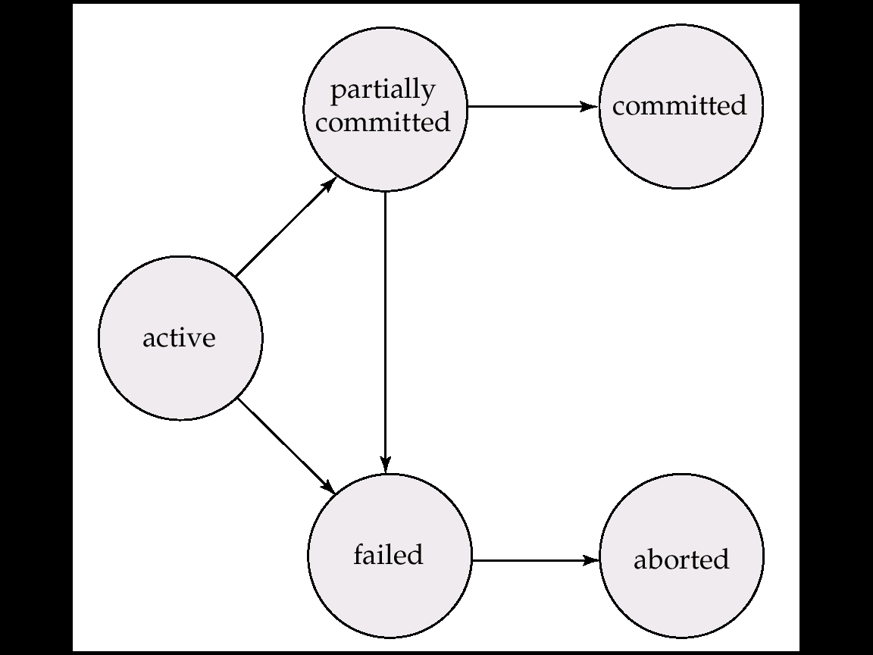
Transaction States
begin-transaction
commit
rollback
Fig.17.1. State diagram of a transaction

Slide 30
Transaction
begin-trans.
op₁;
op_{i};
…
op_{j};
op_{n};
commit.
e.g.
select
e.g. insert,
update
DBMS
allocate
resources,
e.g. local buffer;
create and start trans.
reflect data
to disk
release
Resources;
end trans.
local
-buff.
x, y
disk
-buff.
disk
partially
commit
states:
active
commit
Fig.17.0.5 A successful/committed transaction

Slide 31
Transaction
begin-trans.
op₁;
op_{i};
…
op_{j};
op_{n};
rollback
e.g.
select
e.g. insert,
update
DBMS
allocate
resources,
e.g. local buffer;
create and start trans.
rollback
(undo or redo)
the previous
operations
release
resources;
end trans.
local
-buff.
disk
-buff.
restore
Disk
states:
active
failed
aborted
Fig.17.0.6 A rollback transaction

Slide 32
Transaction States
Active
the initial state, the transaction stays in this state while it is executing from begin-transaction
in this state, the transaction is created (after begin-transaction is submitted), resources, e.g. local buffer are allocated to the transaction
e.g.
Note
transaction operations are executed, but the modifications on DB issued by operations may only stored temporally in the disk buffer, not reflected to DB file on disks immediately

Slide 33
Transaction States
Partially committed (部分提交) :
after the final statement (i.e. Commit ) has been submitted, the transaction enters this state
in this state, the influences that the transaction’s operations have made on DB are reflected from the disk buffer to DB by DBMS
/*DBMS将disk缓冲区中的DB修改结果写入磁盘DB文件中——持久化
e.g.

Slide 34
Transaction States
Committed
after the transaction has successfully completed all its operations, and all the results of these operations have been reflected to the DB in partial commit state, it enters this state
in this state, the transaction
releases the resources occupied
and then terminated (quits DBS),
the cycle-life of the transaction is ended
e.g.

Slide 35
Transaction States
Failed
if it is discovered that normal execution can no longer proceed, the transaction enters this state
e.g. transfer T₂ in Fig.17.0.1
in this state, the transaction is rolled back to restore DB to the state prior to the start of the transactions (§19)
/*在此状态下进行失败处理工作
e.g. Fig.17.0.6

Slide 36
Transaction States
Aborted (夭折/异常结束/中止状态)
after the transaction has been rolled back in failed state, and the DB has been restored to its state prior to the start of the transactions, it enters this state to end the transaction
/*表示DBMS已完成失败处理工作, 事务将要退出系统
in this state, the transaction
releases the resources occupied
reports to its user that the transaction is aborted
and then terminated (quits DBS)
, the cycle-life of the transaction is ended
e.g. Fig.17.0.6

Slide 37
An Example of Roll Back in Transaction
Roll back (回滚、滚回)
撤销到目前为止事务已经对数据库做的所有修改，使数据库状态恢复到事务开始前的状态
E.g. define table SC as
create table SC
(s# integer,
c# integer,
grade integer,
check (grade between 0 AND 100 )
)
define the update transaction update-tran as:
update SC
set grade = grade + 5
where ….

Slide 38
restore/rollback the
tuples updated
update on some tuples
s# | c# | grade
101 | 1 | 85
102 | 2 | 55
201 | 2 | 75
210 | 5 | 100
401 | 3 | 77
… | … | …
510 | 2 | 60
s# | c# | grade
101 | 1 | 90
102 | 2 | 60
201 | 2 | 80
210 | 5 | 105
401 | 3 | 77
… | … | …
510 | 2 | 60
s# | c# | grade
101 | 1 | 85
102 | 2 | 55
201 | 2 | 75
210 | 5 | 100
401 | 3 | 77
… | … | …
510 | 2 | 60
(a) the initial
SC instance
(b) SC instance when failure occurs during execution of transaction, i.e. integrity is violated
(c) SC instance after roll back, i.e. canceling all the updates on SC having been made, equal to the initial instance

Slide 39
An Example of Roll Back in Transaction
When tuple 1, 2, 3 have been successfully updated and tuple 4 is updated, the values of t4[grade]=105 >100, the integrity is violated
DBMS rollbacks the transaction update-tran
restore the values of t1[grade], t2[grade], t3[grade] and t4[grade] to its initial values
Another Example
importing data into DB in SQL Server, where existing some error data (e.g. unmatched data type ) in the input files

Slide 40
17.5 Transaction Isolation
Scheduling on concurrent transactions
Concurrent executions of a set of transactions allows
high throughput and resource utilization, reduced waiting time
e.g. the multi-user ticket-ordering system
Demerits for allowing transaction concurrency
for a set of transactions which contain operations on shared data, the different schedules (serial, concurrent) may result in different final DB states after all these transactions terminate
Concurrency-control schemes and transaction schedules are needed

Slide 41
Concurrent Executions &Scheduling
A schedule on a set of concurrent transactions, arranged by DBMS concurrency-control component, specifies the chronological order in which instructions/operations of concurrent transactions are executed
a schedule for a set of transactions must consist of all instructions of those transactions
must preserve the order in which the instructions appear in each individual transaction.
A transaction that successfully completes its execution will have a commit instructions as the last statement
A transaction that fails to successfully complete its execution will have an abort instruction as the last statement

Slide 42
An Example
T₁： transfer $50 funds from account-A to account-B
T₂: transfer 10% of the balance from A to B
initial value of A : $1000
initial value of B : $2000
initial ( A + B ) : $3000

Slide 43
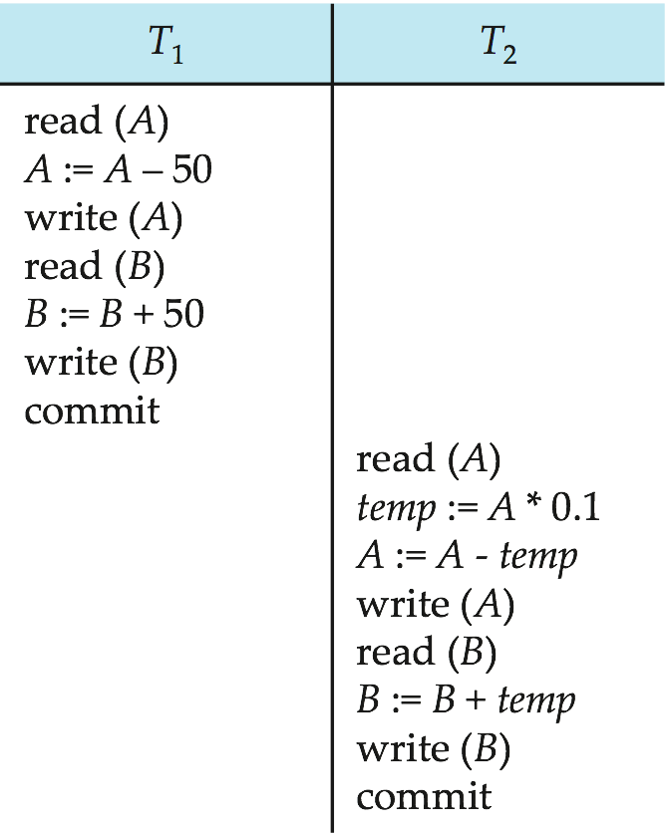
A=950, B=1050
Final results:
A=$855, B=$2145
(A + B) = $3000
Fig.17.2 Serial S1 i.e. T₁; T₂

Slide 44
S1:
T1:
read (A1)
A1:= A1-50
write (A1)
read (B1)
B1:= B1+50
write(B1)
T2 account-A DB file account-B DB file
$1000 $2000
$1000
$1000
$950
$950
$855
$2000
$2000
$2050
$2050
$2145
Fig.17.0.7 Analysis of serial schedule S1
read (A2)
temp:= A2*0.1
A2 := A2- temp
write (A2)
read (B2)
B2:= B2 + temp
write(B2)
time t
temp=95, Final ( A + B ) = $855 + $2145 = $3000

Slide 45
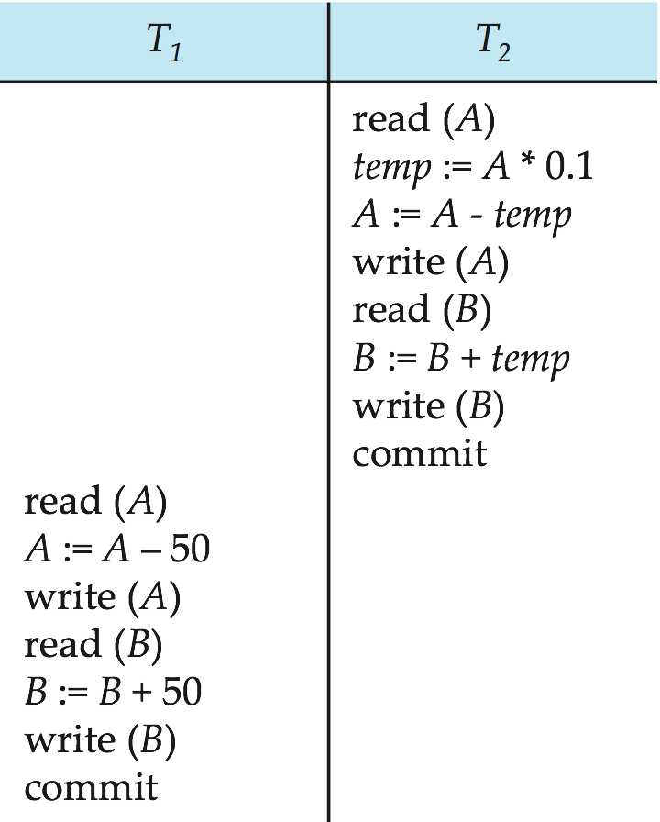
An Example (cont.)
After T1 and T2 are finished under the constraints of the schedule S2,
the sum of A and B is preserved as 3000
the final value of account-A is 850
the final value of account-B is 2150
Serial schedule S1 and S2 result in different final values of shared data items A and B,
though they are all correct schedules
Fig.17.3 Serial S2 i.e. T2; T1

Slide 46
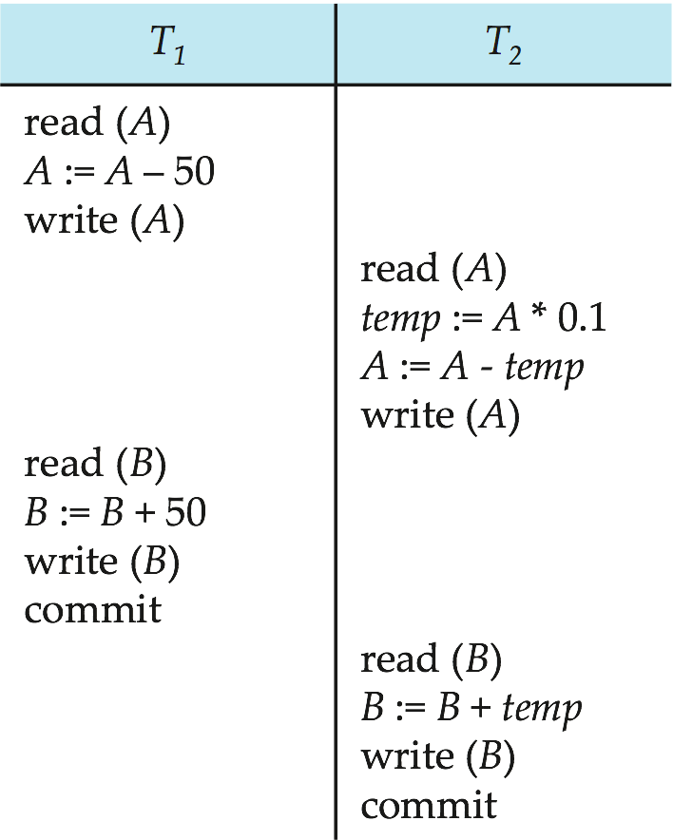
Final results
A=$855, B=$2145
(A + B) = $3000
并发调度S3将对A的2次写操作、对B的2次写操作安排在相近时间执行，利于DBMS在checkpoint、commit时刻一次性地将A、B的修改结果写回数据库文件，减少DB file的写/output操作次数；
类似地，将针对A的2次读操作、针对B的2次读操作安排在相近时间执行，有利于减少对DB file 的读/input操作次数
output to DB file
on disk
output to DB file
Fig.17.4 S3

Slide 47
S3:
T1:
read(A1)
A1:= A1-50
write(A1)
read (B1)
B1:= B1+50
write(B1)
T2 account-A DB file account-B DB file
$1000 $2000
$2000
$2000
$2050
$2050
$2145
$1000
$1000
$950
$950
$855
read (A2) =950
temp:= A2*0.1
A2 := A2- temp
write(A2)
read (B2)
B2:= B2 + temp
write(B2)
Fig.17.0.8 Analysis of concurrent schedule S3
time t
temp=95 , final ( A + B ) = $855 + $2145 = $3000

Slide 48
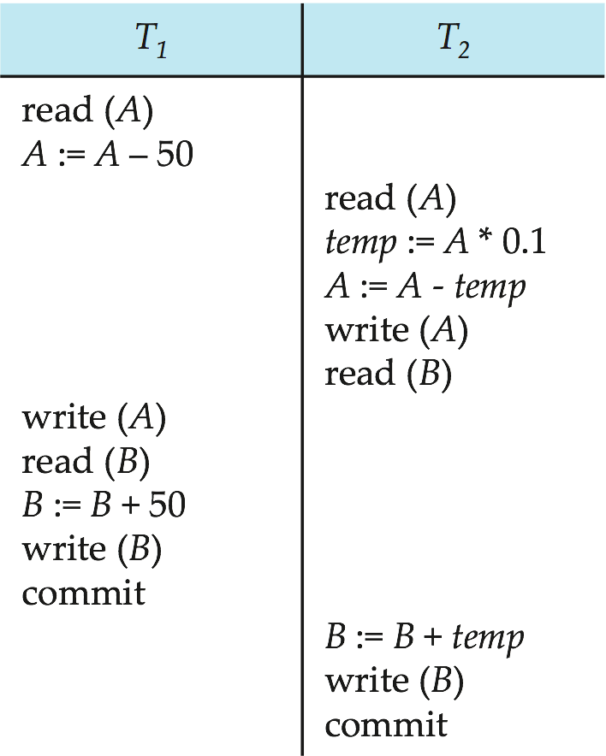
Note:
assuming in Fig.17.0.9, read fetches data directly from DB file on disk
Final results:
A=$950, B=$2100
(A + B) = $3050
Fig.17.5 Concurrent S4

Slide 49
S4:
T1:
read(A1)
A1:= A1-50 =950
write (A1)
read(B1)
B1:= B1+50 =2050
write (B1)
T2 account-A DB file account-B DB file
$1000 $2000
$2000
$2000
$2000
$2050
$2100
$1000
$1000
$1000
$900
$950
read(A2)=1000
temp:= A2*0.1=100
A2 := A2- temp=900
write (A2)
read(B2)=2000
B2:= B2 + temp
write(B2)
Fig.14.0.9 Concurrent schedule S4
time t
A1=950, temp=100, final ( A + B ) = $950+ $2100 = $3050

Slide 50
Why S3 gives a correct result, while S4 leaves a wrong state ?
In S3, T1 and T2 access shared data A and B serially
with respect to shared data A and B, S3 has the same executing results as serial S1, and S3 is equivalent to serial S1
In S4
T1 and T2 operate on shared data A and B in interweaving (交错, 交织) ways
S4 has not the same executing results as serial S1, and is not equivalent to serial S1;
S4 leaves the database in an inconsistent state, and isolation and consistency are violated

Slide 51
17.6 Serializability
/*数据库系统中，多个事务的串行执行可以保证事务的ACID特性（如S1, S2），但执行效率低
/*多个事务并发执行时，如果事务操作的调度顺序不当（如S4），将影响DBS正确性
e.g. S4 in
/*事务并发控制基本原理
事务调度可串行化:
相互冲突的操作串行执行，非冲突操作并行/交织执行
e.g. S3 in

Slide 52
Serializability
How to identify whether or not a concurrent schedule S on a set of transactions is right ?
S is equivalent to a serial one S’ ?
Basic Assumption
each transaction preserves database consistency
thus, serial execution of a set of transactions preserves database consistency
A (possibly concurrent) schedule is serializable if it is equivalent to a serial schedule.
/*将对S正确性的判断转换为对S可串行性的判断
Different forms of schedule equivalence give rise to the notions of:
conflict equivalence/ conflict serializability
view equivalence/ view serializability

Slide 53
Conflict Serializability
Given two transactions T_{i} = { I_{i} }, T_{j} = { I_{j} }, and a schedule S on T_{i} and T_{j}
I_{i} of transactions T_{i} and I_{j} of T_{j} are conflict, if and only if
there exists some item Q accessed by both I_{i} and I_{j}, and at least one of these two instructions is write(Q)
i.e.
I_{i} = read(Q), I_{j} = write(Q)
I_{i} = write(Q), I_{j} = read(Q)
I_{i} = write(Q), I_{j} = write(Q)
l_{i} = read(Q), l_{j} = read(Q),
l_{i} and l_{j} don’t conflict.

Slide 54
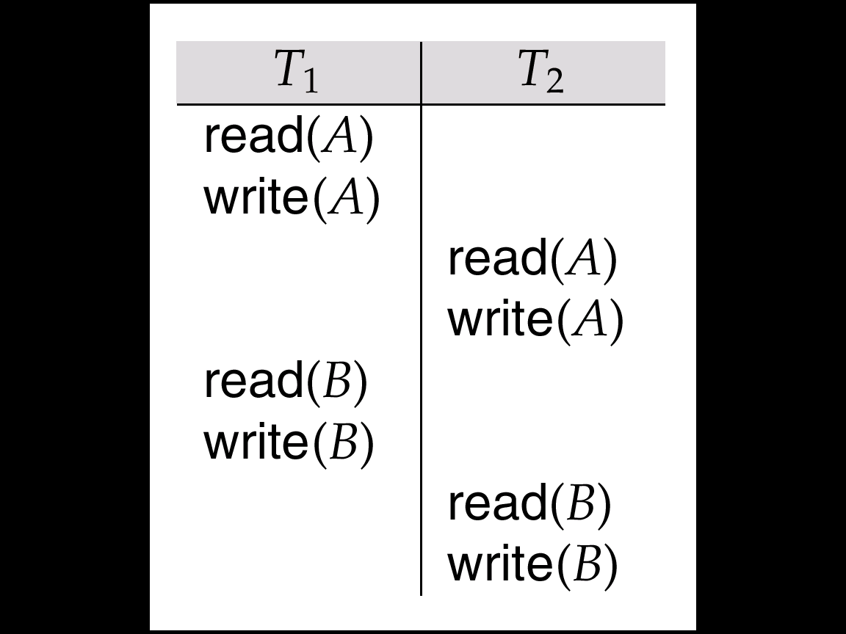
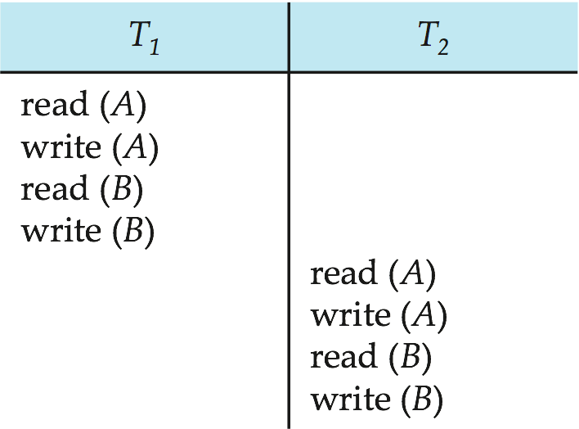
Conflict Serializability
S and S’ are conflict equivalent
if the schedule S can be transformed into S’ by a series of swaps of non-conflicting instructions
e.g.
read(B)
write(A)
Fig.17.7 S5
Fig.17.8 S6

Slide 55
Conflict Serializability
Note:
only swapping of two operations/instructions I_{i} and I_{j} that belong to two different T_{i} and T_{j} respectively are permitted
swapping should not change the orders of instruction executing in each transaction
e.g. in Fig.17.7, swapping of read(B) and write(B) in T₁ is not allowed
swapping should not change the orders of conflict instruction executing in S
e.g. in Fig.17.7, swapping of write(A) in T₁ and read(A) in T₂ is not allowed

Slide 56
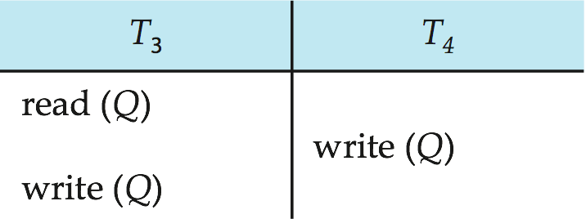
Conflict Serializability
A concurrent schedule S is conflict serializable if it is conflict equivalent to a serial schedule S’
e.g. concurrent S5 in Fig.17.7 is equivalent to S6 in Fig.17.8
There are some schedules of transactions, which are not conflict serializable
e.g.

Slide 57
Identification of Conflict Serializability
Given a concurrent schedule S, how to determine whether or not S is conflict serializable (i.e. is right) ?
Method 1
starting from the concurrent S, maintaining executing orders of conflicting operations in S, and swapping executing orders of non-conflicting operations in S
observing whether or not a serial S’ can be obtained
Method 2
precedence-graph in Fig.17.10, 17.11

Slide 58
An Example
Given the following concurrent schedule S on transactions T1, T2, T3, and T4
determine whether or not S is conflict-serializable ?
if S is conflict-serializable, give its equivalent serial schedule; and if it is not, give the reason
Time T1 T2 T3 T4
1 read(X)
2 write(X)
3 write(Y)
4 read(Y)
5 read(Y)
6 read(X)
7 write(Z)
8 write(X)
Fig.17.0.10
Answer: S is equivalent to <T3; T2; T4; T1>

Slide 59
Precedence-graph
Given a schedule S of a set of transactions T₁, T₂, ..., T_{n} , the precedence graph (前趋图) G(S) for S is
a direct graph G(V, E) where the vertices are the transactions
an arc from T_{i} → T_{j} , for which one of three conditions holds
T_{i} executes write(Q) before T_{j} executes read(Q),
T_{i} executes read(Q) before T_{j} executes write(Q)
T_{i} executes write(Q) before T_{j} executes write(Q)
T_{i} T_{j}
T_{i} T_{j}
T_{i} T_{j}
.
.
.
read(Q)
.
.
.
.
.
write(Q)
.
.
.
.
.
write(Q)
.
.
write(Q)
.
.
.
.
read(Q)
.
.
.
.
write(Q)
.
.
.
.
.
Fig. 17.0.11 Cases for arc T_{i} → T_{j} in precedence graphs
t
(a)
(b)
(c)

Slide 60
Precedence-graph
A schedule is conflict serializable if and only if its precedence graph is acyclic
E.g. Concurrent schedule S (in the next slide) and its precedence graph
T₁
T₂
T₅
T₄
T₃
Fig.17.0.12 Precedence graph for S

Slide 61
T₁ T₂ T₃ T₄ T₅ read(X) read(Y) read(Z) read(V) read(W) read(W) read(Y) write(Y) write(Z) read(U) read(Y) write(Y) read(Z) write(Z)
read(U) write(U)

Slide 62
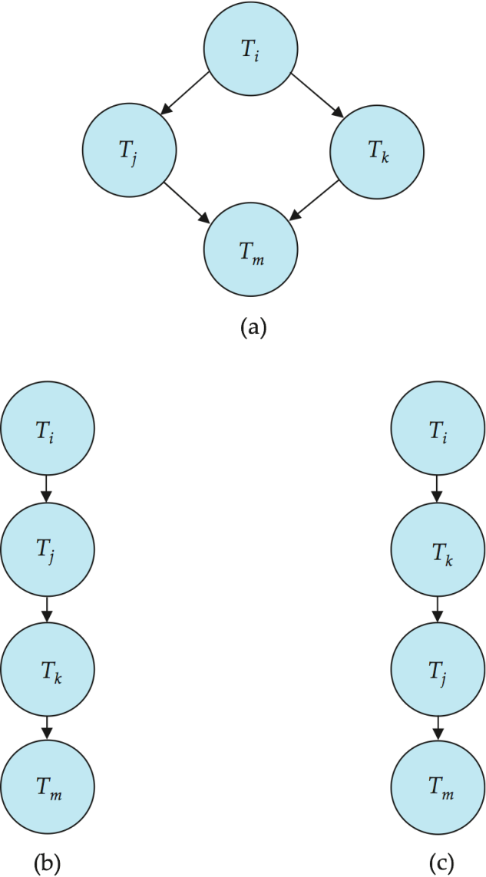
Testing for Conflict Serializability
Cycle-detection algorithms exist which take order n² time, where n is the number of vertices in the graph.
Better algorithms take order n + e where e is the number of edges
If precedence graph is acyclic, the serializability order can be obtained by a topological sorting of the graph.
That is, a linear order consistent with the partial order of the graph.
For example, a serializability order for the schedule (a) would be one of either (b) or (c)

Slide 63
Construction of Conflict Serializable Concurrent Schedule
Given a serial schedule S, how to construct a concurrent S’, which is conflict equivalent to S
starting from schedule S, maintaining executing orders of conflicting operations in S, and swapping executing orders of non-conflicting operations in S, resulting in a conflict serializable S’
e.g. serial schedule S6 in Fig.17.8 and concurrent S5 in Fig.17.7

Slide 64
17.7 Transaction Isolation and Atomicity
Two types of schedules
recoverable scheduling
cascadeless scheduling
Recoverability address how to deal with the schedules when transaction failures occur
Requirements
when transaction T_{i} fails, the operations already executed should be rollbacked/undone/aborted/canceled to ensure the atomicity
when transaction T_{i} fails, any T_{j} that is dependent on T_{i} should also be aborted
e.g. T_{j} reads data having been written by T_{i}
计算成绩最大值 插入/修改/更新个人成绩

Slide 65
Recoverability
A recoverable schedule is a schedule, where for each pair of T_{i} and T_{j}
if T_{j} reads a data items previously written by T_{i} , the commit operation of T_{i} appears before the commit operation of T_{j}.
//解释：
T_{j} 依赖于 T_{i}；当T_{i}中的write(Q)需要aborted/rollback时，由于T_{j}还没有提交，T_{j}没有commit，因此T_{j}可以rollback, T_{j}中的read(Q) 操作也随之aborted/undo
T_{i} T_{j}
write(Q)
.
.
read(Q)
.
.
commit
故障/回滚点
.
commit
回滚点
Fig.17.0.18 Definition of recoverable schedule

Slide 66
An example of non-recoverable schedule
SC(s#, c#, grade)
check(0<= grade <=100)
MaxGrade(c#, maxG)

Slide 67
s# | c# | grade
101 | 1 | 90
102 | 2 | 95
s# | c# | grade
101 | 1 | 90
102 | 2 | 95
103 | 2 | 97
s# | c# | grade
101 | 1 | 95
102 | 2 | 100
103 | 2 | 97+5?
s# | c# | grade
101 | 1 | 90
102 | 2 | 95
初始
T_{i}整体回滚结束后
引发update，insert回滚
SET XACT_ABORT ON
T_{i}: T_{j}
begin transaction
insert into SC
value (103, 2, 97);
begin transaction
insert into MaxGrade(c#, maxG)
select c#,max(grade)
from SC
group by c#
commit
update SC
set grade=grade+5;
commit
不可恢复
调度
check约束：
0<=grade<=100
Ti结束后，
结果错误
c# | maxG
c# | maxG
1 | 90
2 | 96
初始为空

Slide 68
SQL Server Rollback
SQL Server利用语句和参数：
SET XACT_ABORT { ON | OFF } 指定当 Transact-SQL 语句产生运行时错误时，是否自动回滚当前事务
为 ON 时，如果 Transact-SQL 语句产生运行时错误，整个事务将终止并回滚
为 OFF 时，只回滚产生错误的 Transact-SQL 语句，而事务将继续进行处理
默认情况下SQL Server只是Rollback出错的语句，而不是整个事务，即SET XACT_ABORT OFF
如果想Rollback整个事务，可以选择SET XACT_ABORT ON

Slide 69
s# | c# | grade
101 | 1 | 90
102 | 2 | 95
s# | c# | grade
101 | 1 | 90
102 | 2 | 95
103 | 2 | 97
s# | c# | grade
101 | 1 | 95
102 | 2 | 100
103 | 2 | 97+5?
s# | c# | grade
101 | 1 | 90
102 | 2 | 95
103 | 2 | 97
初始
update回滚
insert未回滚
SET XACT_ABORT OFF
T_{i}: T_{j}
begin transaction
insert into SC
value (103, 2, 97);
begin transaction
insert into MaxGrade(c#,maxG)
select c#,max(grade)
from SC group by c#
commit
update SC
set grade=grade+5;
commit
不可恢复
调度
引发update回滚
check约束：
0<=grade<=100
T_{i}结束后
，结果正确
c# | maxG
c# | maxG
1 | 90
2 | 97
初始为空

Slide 70
s# | c# | grade
101 | 1 | 90
102 | 2 | 95
s# | c# | grade
101 | 1 | 90
102 | 2 | 95
103 | 2 | 97
s# | c# | grade
101 | 1 | 95
102 | 2 | 100
103 | 2 | 97+5?
s# | c# | grade
101 | 1 | 90
102 | 2 | 95
初始
T_{i}整体回滚
结束后
SET XACT_ABORT ON
引发update整体回滚
T_{i}: T_{j}
begin transaction
insert into SC
value (103, 2, 97);
update SC
set grade=grade+5;
begin transaction
insert into MaxGrade(c#,maxG)
select c#,max(grade)
from SC group by c#
commit
commit
可恢复调度
check约束：
0<=grade<=100
T2结束后
，结果正确
c# | maxG
c# | maxG
1 | 90
2 | 95
初始为空

Slide 71
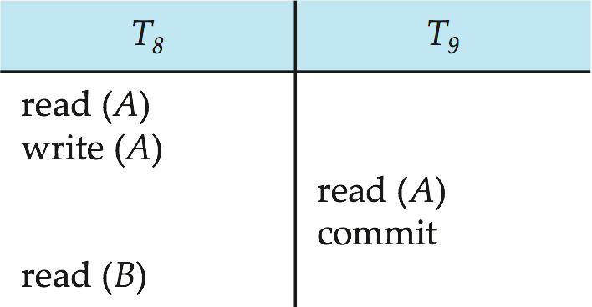
An example of non-recoverable schedule
S9 in Fig.17.14 is not recoverable if T₉ commits immediately after the read(A)
if T₈ is aborted after T₉ has been committed, the value of the data item A will be rollbacked to its old value before T₈ executes.
but T₉ has read the new value of the data item A and has been committed
commit
Fig.17.14 S9

Slide 72
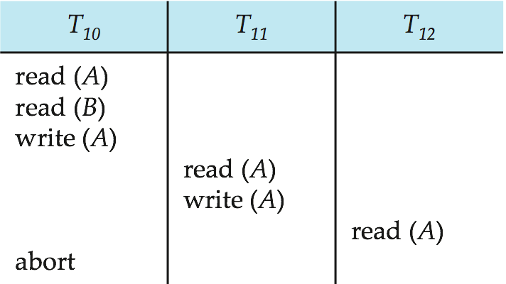
Cascadeless Schedules
Cascading rollback
a single transaction failure leads to a series of transaction rollbacks
E.g. before T₁₀, T₁₁ and T₁₂ are committed, just after T₁₂ reads the item A, when T₁₀ rollbacks due to failures, its dependent transactions T₁₁ should also rollback, resulting in T₁₂ also rollback
A=10
A=20
Fig.17.15 S10
A=30
A=30

Slide 73
s# | c# | grade
101 | 1 | 90
102 | 2 | 95
s# | c# | grade
101 | 1 | 90
102 | 2 | 95
103 | 2 | 97
s# | c# | grade
101 | 1 | 95
102 | 2 | 100
103 | 2 | 97+5?
s# | c# | grade
101 | 1 | 90
102 | 1 | 95
初始
T1整体回滚结束后
SET XACT_ABORT ON: 整体回滚
级联回滚调度
T₁₂
begin transaction
select avg(maxG)
from MaxGrade
T₁₀: T₁₁
begin transaction
insert into SC
value (103, 2, 97);
begin transaction
insert into MaxGrade(c#,maxG)
select c#,max(grade)
from SC group by c#
update SC
set grade=grade+5;
commit/rollback
c# | maxG
1 | 90
2 | 96
c# | maxG
1 | 90
2 | 95
avgG
93
avgG
92.5
rollback

Slide 74
s# | c# | grade
101 | 1 | 90
102 | 2 | 95
s# | c# | grade
101 | 1 | 90
102 | 2 | 95
103 | 2 | 97
s# | c# | grade
101 | 1 | 95
102 | 2 | 100
103 | 2 | 97+5?
s# | c# | grade
101 | 1 | 90
102 | 2 | 95
初始
T₁₀整体回滚结束后
SET XACT_ABORT ON
无级联回滚调度
T₁₂
begin transaction
select avg(maxG)
from MaxGrade
T₁₀: T₁₁
begin transaction
insert into SC
value (103, 2, 97);
update SC
set grade=grade+5;
commit
begin transaction
insert into MaxGrade(c#,maxG)
select c#,max(grade)
from SC group by c#
commit
c# | maxG
1 | 90
2 | 95
avgG
92.5

Slide 75
Cascadeless Schedules
Cascading rollback is undesirable, because it leads to the undoing of a significant amount of previous works;
Cascadeless schedules is expected for concurrent transactions
Cascadeless schedules are the schedules that cascading rollbacks cannot occur; formally,
for each pair of transactions T_{i} and T_{j} such that T_{j} reads a data item Q previously written by T_{i}, the commit operation of T_{i} appears before the read operation of T_{j}.
Fig.17.0.19

Slide 76
Cascadeless Schedules
T_{i} T_{j}
T_{j}只能读取已提交事务T_{i}所更新的、不会再修改的数据
T_{i} T_{j}
write(Q)
.
.
.
read(Q)
write(Q)
.
.
read(Q)
..
commit
.
.
commit
.
commit
.
commit
Fig.17.0.19
Definition of cascadeless schedule
/*注意与 recoverable schedule定义的区别
Fig.17.0.18
Definition of recoverable schedule

Slide 77
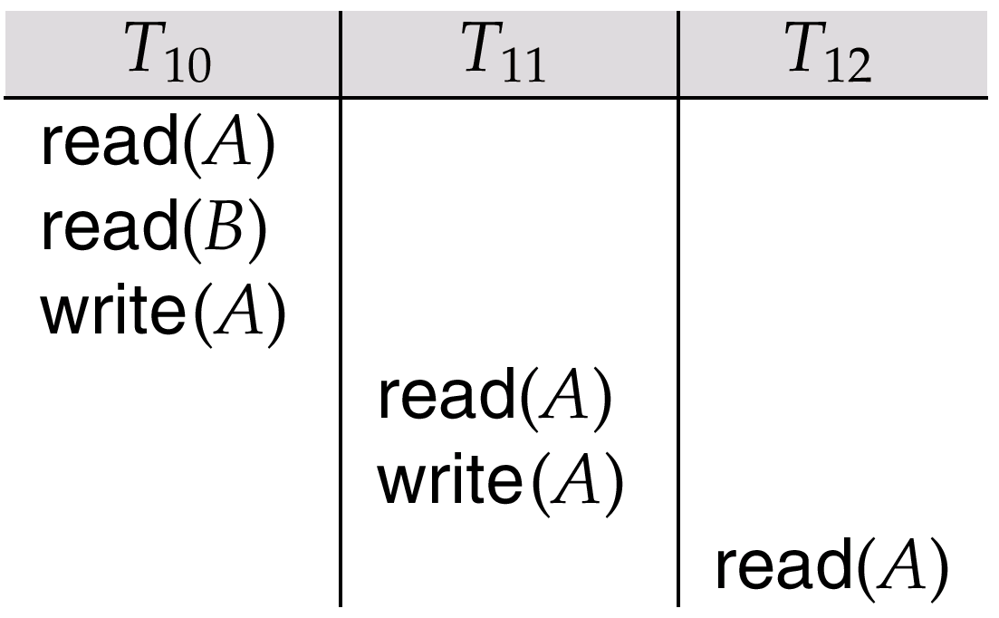
Cascadeless schedule vs recoverable schedule
Every cascadeless schedule is also recoverable！
But a recoverable may not be a cascadeless schedule
An example of cascadeless and recoverable schedule in Fig.17.0.20
commit
commit
commit
commit

Slide 78
17.8 Transaction Isolation Level
A database must provide a mechanism that will ensure that all possible schedules are both:
Conflict serializable.
Recoverable and preferably cascadeless
A policy in which only one transaction can execute at a time generates serial schedules, but provides a poor degree of concurrency
Concurrency-control schemes tradeoff between the amount of concurrency they allow and the amount of overhead that they incur
Goal – to develop concurrency control protocols that will assure serializability.

Slide 79
Weak Levels of Consistency
Some applications are willing to live with weak levels of consistency, allowing schedules that are not serializable
E.g., a read-only transaction that wants to get an approximate total balance of all accounts
E.g., database statistics computed for query optimization can be approximate (refer to Chapter 15, why?)
Such transactions need not be serializable with respect to other transactions
Tradeoff accuracy for performance
为提高并发事务执行效率，放松一致性要求：
1）允许一定程度的“读-写”、“写-读”冲突
2）仍然严格保证无冲突的“写-写”

Slide 80
Levels of Consistency in SQL-92
Serializable — default
【严格的无冲突“写-写”、“写-读”、 “读-写”】
Repeatable read — only committed records to be read, repeated reads of same record must return same value. However, a transaction may not be serializable – it may find some records inserted by a transaction but not find others.
Read committed — only committed records can be read, but successive reads of record may return different (but committed) values.
Read uncommitted — even uncommitted records may be read
Oracle
set transaction isolation level serializable
DB2
change isolation level

Slide 81
Levels of Consistency in SQL-92
Lower degrees of consistency useful for gathering approximate information about the database
Warning: some database systems do not ensure serializable schedules by default
e.g., Oracle and PostgreSQL by default support a level of consistency called snapshot isolation (not part of the SQL standard)

Slide 82
17.9 Implementation of Isolation Levels
Locking
Lock on whole database vs lock on items
How long to hold lock?
Shared vs exclusive locks
Timestamp
Transaction timestamp assigned e.g. when a transaction begins
Data items store two timestamps
Read timestamp
Write timestamp
Timestamps are used to detect out of order accesses
Multiple Versions and Snapshot Isolation
allow transactions to read from a “snapshot” of the database
For more details, refer to Chapter 18

Slide 83
17.10 Transactions as SQL Statements
Data manipulation language must include a construct for specifying the set of actions that comprise a transaction.
In SQL, a transaction begins implicitly.
A transaction in SQL ends by:
Commit work commits current transaction and begins a new one.
Rollback work causes current transaction to abort.
In almost all database systems, by default, every SQL statement also commits implicitly if it executes successfully
Implicit commit can be turned off by a database directive
E.g. in JDBC, connection.setAutoCommit(false);
Isolation level can be set at database level
Isolation level can be changed at start of transaction
E.g. In SQL set transaction isolation level serializable
E.g. in JDBC -- connection.setTransactionIsolation( Connection.TRANSACTION_SERIALIZABLE)

Slide 84
Examples
E.g., Transaction 1: select ID, name from instructor where salary > 90000
E.g., Transaction 2: insert into instructor values ('11111', 'James', 'Marketing', 100000)
Suppose
T1 starts, finds tuples salary > 90000 using index and locks them
And then T2 executes.
Do T1 and T2 conflict? Does tuple level locking detect the conflict?
Instance of the phantom phenomenon
Also consider T3 below, with Wu’s salary = 90000 update instructor set salary = salary * 1.1 where name = 'Wu’
Key idea: Detect “predicate” conflicts, and use some form of “predicate locking”

Slide 85
Appendix 17-1 Transactions in SQL Server
SQL Server系统中有三种事务执行模式：显示、自动提交、隐性，用于启动事务执行
Explicit transactions
delimited by begin-transaction and commit or rollback
defined by user/application program, explicitly controlled by user
工作在SQL Server系统的显示事务执行模式下
e.g. account-transfer transaction in Fig.17.0.2
MySQL: start transaction

Slide 86
Transactions in SQL Server
Auto-commit transactions
SQL Server 默认的事务管理模式
在此模式下，每条单独的Transact-SQL语句均是一个事务
e.g.
CREATE, ALTER TABLE, SELECT, UPDATE, INSERT, DELETE, DROP, FETCH, OPEN
每条语句完成时，可以成功提交(commit)，也可以失败滚回 (rollback)
e.g. update SC
set Grade=Grade +10
当某个学生Grade已经超过99，再执行本语句将导致事务回滚，SQL Server撤销整个更新语句的执行结果

Slide 87
Transactions in SQL Server
Implicit transactions /隐性事务
SQL Server系统利用隐性事务模式设置命令设置系统的事务执行模式
set implicit_transaction on
在此模式下，每个事务无需（用begin-transition）显示地定义事务的开始，但仍以显示的commit or rollback结束
当一个事务结束后，系统自动启动下一个事务，无需begin-transition，形成连续的事务链

Slide 88
set implicit_transaction on
op₁;
op₂;
…
op_{m}
commit;
op_{m+1};
op_{m+2};
…
op_{k}
rollback;
…
set implicit_transaction off
（用户定义） (单独T-SQL语句, 每
条语句对应一个单独隐性事务)
Create;
Drop;
….
Select;
Open;
Drop;
Insert;
Delete;
Update;
…
隐性事务执行模式
事务1
事务2

Slide 89
SQL Server 批处理中的事务
批处理
包含1个或多个SQL语句的组，由应用程序从客户端一次性地发送到服务器端的DBMS引擎去执行执行
事务与批之间多对多关系
1个事务可以包括多个批，1个批中也可以由多个事务组成
SQL Server系统中，在大多数情况下，当批中的某些SQL语句执行发生错误时，DBMS将停止执行当前语句及其后面的语句，但发生错误之前已经执行的语句是有效的，不会被回滚(rollback)
SET XACT_ABORT OFF

Slide 90
Check 语义约束： grade between 0 and 100
begin tran
insert into SC values (‘s1’, ‘c1’, 90)
update SC
set GRADE=GRADE + 12
commit tran
select * from SC
------
update 操作被回滚；
但Insert 操作未被回滚，(‘s1’, ‘c1’, 90)被成功插入；
不满足事务原子性要求！Why?
SET XACT_ABORT OFF

Slide 91
SQL Server 批处理中的事务
SQL Server 中，如果需要事务中的全部操作/语句作为1个整体，同时提交或回滚，在提交“批”之前，采用下述语句进行设置：
set XACT_ABORT ON
begin tran
insert into SC values (‘s1’, ‘c1’, 90)
update SC
set GRADE=GRADE + 12
commit tran
select * from SC
update 操作、insert操作均被回滚，(‘s1’, ‘c1’, 90)无法插入

Slide 92
Appendix 17-2 Savepoint
SAVEPOINT 语句定义事务执行过程中的中间点/状态
使用保存点将各组相关语句分开可以在事务内标识重要的状态
类似于snapshot
使用 ROLLBACK TO SAVEPOINT 语句可以撤消该点后的所有更改，即将事务的执行退回到以前的状态

Slide 93
BEGIN TRANSACTION
USE student-DB
INSERT INTO student
VALUES (“ 03402”, “王菲”, “CS”, “2000/05/15”)
SAVE TRAN My-savepoint /* defining save-point */
DELETE FROM student
WHERE name= “王菲” or “章立”
ROLLBACK TRAN My-savepoint
COMMIT TRAN
GO
Note
rollback将操作滚回到保存点 My-savepoint: delete 操作被rolled back, 而insert操作则不被rolled back
DB恢复为delete操作执行前的状态，新插入的元组 (“03402”, “王菲”, “CS”, “2000/05/15”)并未被删除，仍然保存在数据库中
Fig.17.0.14 An example of savepoint in T-SQL

Slide 94
st-id | st-name | depart-ment | birth-date
03405 | 章立 | CS | 2000/01/25
… | … | … | …
03409 | 李龙 | CS | 2000/12/20
… | … | … | …
03411 | 赵新 | CS | 2000/06/18
st-id | st-name | depart-ment | birth-date
03402 | 王菲 | CS | 2000/05/15
03405 | 章立 | CS | 2000/01/25
… | … | … | …
03409 | 李龙 | CS | 2000/12/20
… | … | … | …
03411 | 赵新 | CS | 2000/06/18
(a) DB before the transaction starts
(b) DB after insert is issued
Fig.17.0.15-I DB instances at different timepoints

Slide 95
st-id | st-name | department | birth-date
… | … | … | …
03409 | 李龙 | CS | 2000/12/20
… | … | … | …
03411 | 赵新 | CS | 2000/06/18
st-id | st-name | department | birth-date
03402 | 王菲 | CS | 2000/05/15
03405 | 章立 | CS | 2000/01/25
… | … | … | …
03409 | 李龙 | CS | 2000/12/20
… | … | … | …
03411 | 赵新 | CS | 2000/06/18
(c) DB after delete is issued
(d) DB after rollback is issued
Fig.17.0.15-II DB instances at different timepoints

Slide 97

Thanks for your attention

